Slide 1
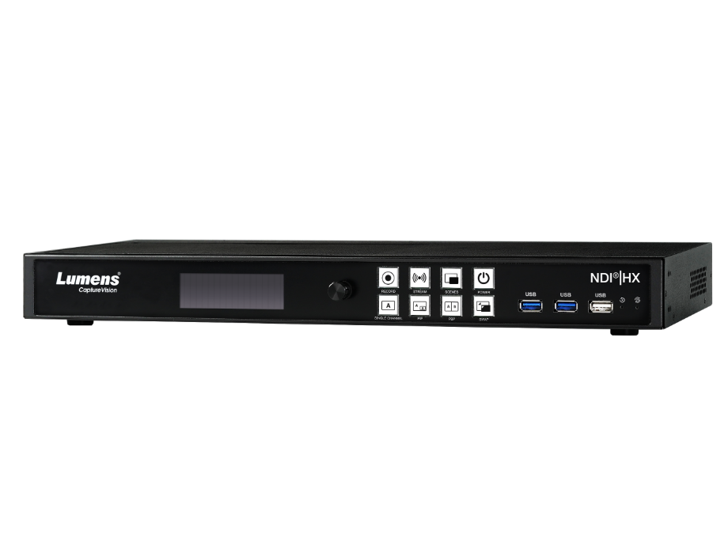
LC100N
2-Channel Recorder and Streaming Media Processor
with NDI®|HX support
Product Introduction
Notes:
Let’s see the new product introduction. LC100N - 2 channel NDI Recorder and Streaming Media Processor.

Slide 2
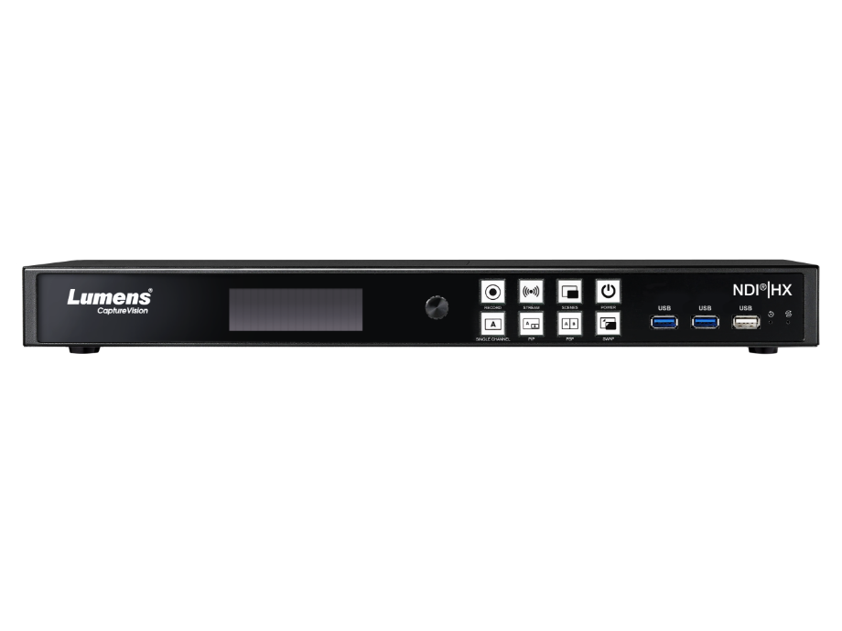
Overview
LC100N
2-Channel
Recorder and Streaming Media Processor
with NDI®|HX support
Color: Black
TAA Compliant: Yes
Warranty: 5-Year
MAP: $2,799
Notes:
Lumens CaptureVision System LC100N is a 2-channel media processor with NDI®|HX support.
The color is available in black. It is TAA Compliant and comes with a 5-years warranty.

Slide 3
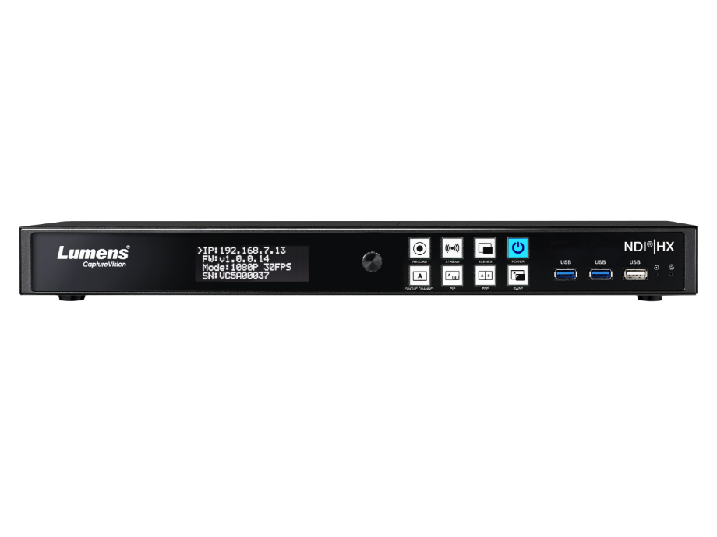
Overview
Recording
Stream
Store
Produce
Switch
All-in-One Video Solution
Recording
Stream
Store
Micro-Production
Switch
Notes:
LC100N is an all-in-one 2-channel media processor that enables you to record, mix and stream live.
Compatible with Panopto, Kaltura and Opencast, it is ideal for use in lecture capture, streaming worship services, producing corporate training, and live event delivery.
Events can be produced live with simple switching between scenes, layouts and sources, with the option of text overlay and logo insert.

Slide 4
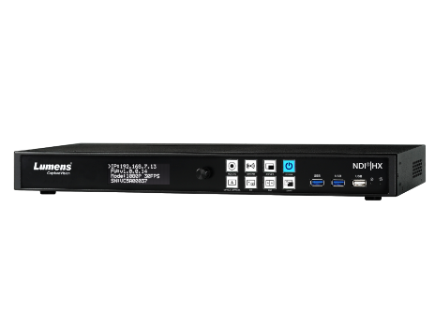
Product Family
LC100N
LC100
MAP Price(USD$) | 2,799 | 2,499
Multi-channel video mixing | 2 video source | 2 video source
Recording Resolution and FPS | 1920 x 1080p 60fps | 1920 x 1080p 60fps
Support RTSP Network source input | Yes, Lumens IP (RTSP) camera and RTSP source | Yes, Lumens IP (RTSP) camera and RTSP source
Support NDI|HX source | Yes, NDI|HX2 Camera NDI|HX Screen Capture | NA
NDI|HX encode | Yes, NDI|HX2 (1080p) | NA
Built-in HD | 2TB HDD | 2TB HDD
Other Streaming Output | RTSP / RTP / RTMP / RTMPS / SRT | RTSP / RTP / RTMP / RTMPS / SRT
Notes:
Compare with LC100, LC100N with NDI®|HX support, the HD quality video can be easily edited and managed, smoothly transferred among the device equipped with the same NDI® protocol.

Slide 5
Product I/O
LC100N Front View
Built-in 2TB HDD
Record and Stream
Power/Standby/Reboot
USB 3.0/USB 2.0
Status Screen
Control Knob
Source/Layout Switch
Notes:
LC100N has a built-in 2TB Hard Disk. It has LCM to display menus and information, like IP address, firmware version...etc.
Users can easily push one button to start recording, stream, reboot, or switch layout.
It supports USB 3 and USB 2, which can support USB storage, mouse, USB camera and USB Microphone

Slide 6
Product I/O
LC100N Back View
USB 3.0
Ethernet
HDMI/SDI IN 1
HDMI/SDI IN 2
XLR Balanced Audio
HDMI Pass-Through (Direct Output from
HDMI IN 1)
Program Out
Multi-view Onboard Director Out
Line In & Line Out
Notes:
On the back, LC100N has 2 HDMI and SDI inputs. And one HDMI-pass-through from HDMI input 1.
It also supports balanced XLR input, and unbalanced line-in.
For XLR input, it can supports audio from audio mixer ,audio DSP, and Microphones that need phantom power.

Slide 7
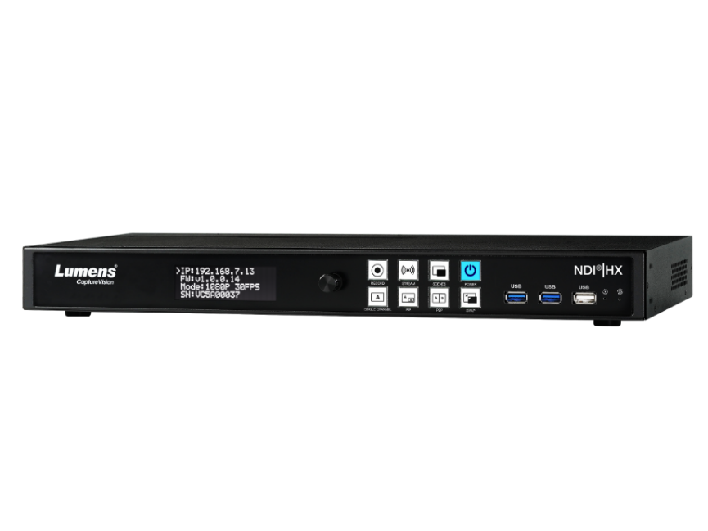
Key Features
2-Channel AV Source Processing
Simultaneous Recording and Streaming
NDI®|HX, HDMI, SDI, RTSP, USB source inputs
XLR with Phantom power
Built-in 2TB HDD storage
Support NAS and FTP storage
Notes:
LC100N can mix 2 video sources and 4 audio inputs, it can recording and streaming simultaneously.
AV inputs include NDI®|HX, HDMI, SDI, RTSP, USB source and the XLR microphone that need phantom power for professional audio.
Built-in 2TB Hard Disk and support for NAS and FTP storage.

Slide 8
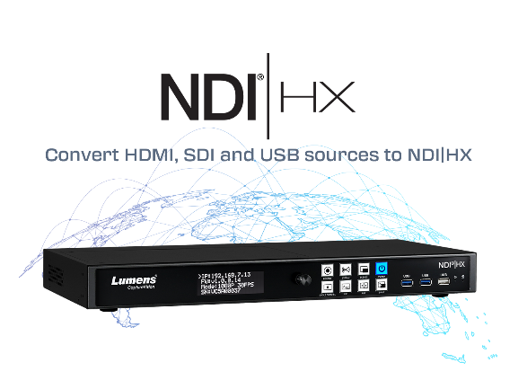
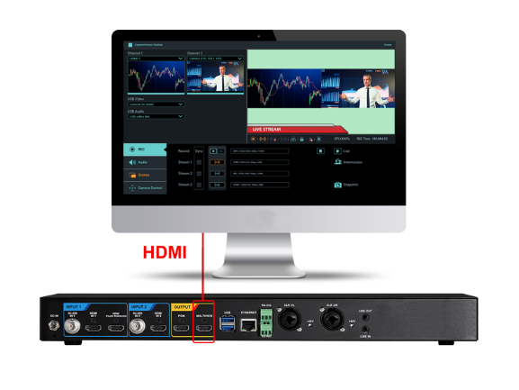
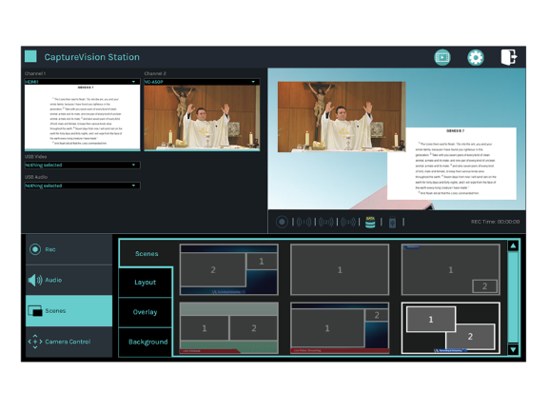
Selling Point
NDI®|HX Support
Onboard GUI Director
Live Pre-defined Scenes for Switching
LC100N can receive multiple 1080p NDI®|HX streams, enabling plug and play network production. The device can also convert HDMI, SDI and USB sources to NDI|HX, allowing the unit to be used as an IP encoder.
Live control is incorporated into the device. Connect an HDMI screen to the LC100N to access the intuitive GUI. Plugging in a mouse and keyboard turns the device into a live production switcher.
Build layout scenes that help you communicate, such as split screen video, picture-in-picture, title/logo overlays, and background images. Activate and change layouts with the click of a mouse.
Notes:
LC100N can receive multiple 1080p NDI®|HX streams, enabling plug and play network production. The device can also convert HDMI, SDI and USB sources to NDI|HX, allowing the unit to be used as an IP encoder.
Live control is incorporated into the device. Connect an HDMI screen to the LC100N to access the intuitive GUI. Plugging in a mouse and keyboard turns the device into a live production switcher.
Build layout scenes that help you communicate, such as split screen video, picture-in-picture, title/logo overlays, and background images. Activate and change layouts with the click of a mouse.

Slide 9
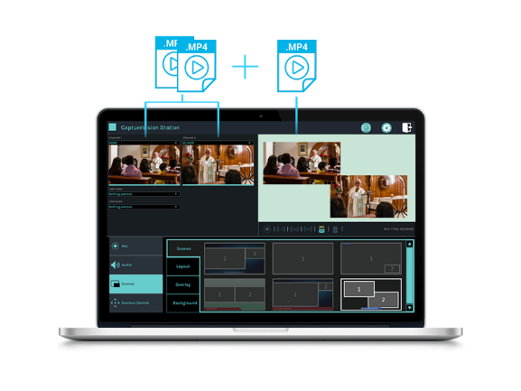
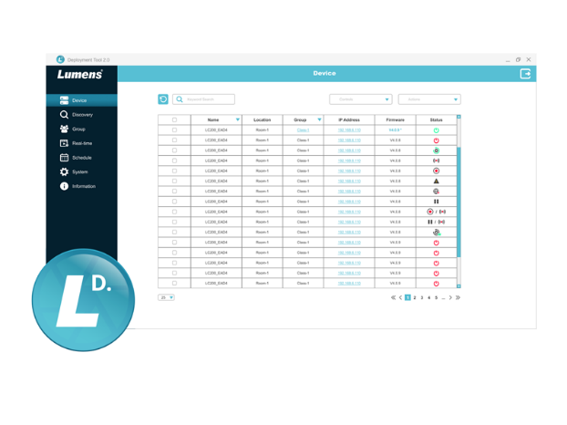
Selling Point
Program & ISO Recording
Deployment Tool for
remote central management
The LC100N records the mixed program-out video and captures two video inputs with independent audio. This simplifies media archiving and post-production.
Lumens deployment software enables control, management, and administration of multiple LC100N units on the network. Administrators can remotely monitor device status, saving time and reducing costs.
Notes:
The LC100N records the mixed program-out video and captures two video inputs with independent audio. This simplifies media archiving and post-production.
Lumens deployment software enables control, management, and administration of multiple LC100N units on the network. Administrators can remotely monitor device status, saving time and reducing costs.

Slide 10
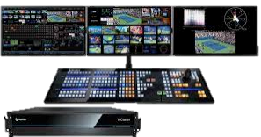
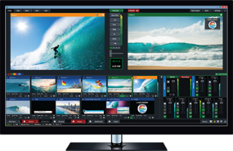
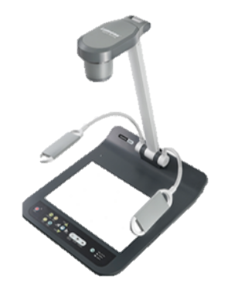
NDI ecosystem
NDI|HX Camera
NewTek TriCaster
IP Camera (RTSP/HDMI/
SDI/USB)
Media Processor LC100N
NDI|HX
vMix
NDI|HX
Screen Capture
Video Production
Document Camera
(HDMI/USB)
Video processing such as PIP, add overlay and background.
Video Sources
NDI Webcam Input
(Virtual Camera)
Video mixing and encoder to NDI|HX
Conference Computer
Notes:
LC100N can be a part of NDI ecosystem.
It can receive the 1080p NDI|HX sources, like NDI|HX camera, or NDI|HX screen capture software.
It can capture the video sources from HDMI, SDI, USB, IP, and do video mixing, and encode the mixing video to NDI|HX.
So, the production switcher or production software that supports NDI can receive the NDI|HX from the LC100N.
Some video conferencing applications hope that the video screen is a programmed PIP screen (such as PPT content, plus the speaker's shooting screen)
LC100N can mix the 2 video source as PIP or PBP screen, with background, overlay.
Because it can output NDI|HX, So, LC100N can be the video source for NDI Webcam Input (NDI Virtual Camera).
This means that the PIP or PBP screen mixed by the LC100N can be added to the video conference application via NDI.

Slide 11
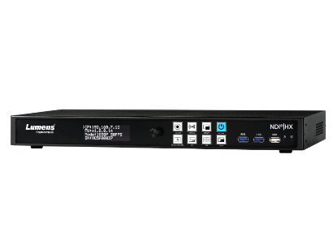
Competitive Products (1)
Lumens LC100N
Epiphan Pearl Nano
Extron SMP351
B&H Price (USD$) | $2,799 | $1,695 | $4,790
Recording Resolution and FPS | 1080p 60fps | 1080p 60fps | 1080p 30fps
Recording mode | 1080p60: 3 files | 1080p60: 1 files | 1080p60: 1 files
PTZ Camera Control | Yes | NA | NA
Video In | HDMI*2 (HDMI 2.0 *1) 3G-SDI *2 IP Video Source *2 (RTSP, NDI|HX2) USB 3.0 *1 | 12G-SDI *1 HDMI *1 IP Stream *1 | HDMI *3 3G-SDI *1 (Optional)
HDMI pass-through | Yes | Yes | NA
Audio In | XLR *2 3.5mm Stereo*1 USB Audio *1 IP Audio from RTSP *2 | XLR *2 RCA (L/R) *1 USB *1 IP Audio from RTSP or SRT *2 | Audio In *2
Storage | Built-in SATA 2TB HDD External: USB 3.0 Storage | SD Card (Up to 512 GB) M.2 (SATA) SSD | Internal 80G SSD
Extension Remote Control Panel | Yes, LC-RC01, up to 30 meter USB extension | USB status light (optional) | Yes, Optional
Warranty | 5-year | 1-year | 3-year
Notes:
LC100N is one of the few 2 channel AV media processors that can support NDI|HX, and provides 5 years warranty.

Slide 12
Competitive Products (2)
Lumens LC100N
NewTek Capture Cast
MAP Price (USD$) | $2,799 | $7,995
Design for Multi-room Recording | No, single room | Yes, 3 rooms
Multi-channel Video Mixing | 2 video sources | 6 video sources (1 room with 2 sources)
Support Network Source Input | NDI|HX2, RTSP | NDI|HB, NDI|HX
IP Camera control | Yes | NA
Video File Export | USB, FTP /FTPS, NAS (CIFS/SMB, NFS) | FTP/SFTP, Dropbox, Google Drive
Video In | HDMI*2 (one HDMI™ 2.0), 3G-SDI*2 IP Video*2, USB 3.0 *1 | IP Video*6
Audio In | XLR *2, 3.5mm Line In *1 HDMI Audio *2, SDI Audio *2 USB Audio *1 IP Audio (RTSP, NDI|HX) *2 | IP Audio (NDI)
Video Out | HDMI out*2 , HDMI pass-through *1 | NA
Ethernet | 1 Gigabit *1 | 10 Gigabit *1 and 1 Gigabit *1
Storage | Built-in: 2TB, External: USB Storage | Built-in: 2TB
Streaming | RTMP / RTMPS, NDI|HX2, RTSP / RTP / SRT | RTMP/RTMPS , NDI|HX
Extension Remote Control Panel | Yes, up to 30 meter | NA
Notes:
The primary competitor is Newtek Capture Cast. The US MSRP is $7,995.
The Capture Cast can record up to 6 NDI|HX or 8 NDI inputs concurrently. It will mainly use in the multi-room solution.
Lumens LC100N is cheaper, and the US MSRP will be 2,799 . It can record up to 2 NDI|HX inputs; we can focus on the single-room solution.

Slide 13
Competitive Products (3)
Lumens LC100N
Datavideo iCast 10NDI
MAP Price (USD$) | $2,799 | $2,679
Multi-channel video mixing | 2 video sources | 4 video sources
Support Network source input | RTSP, NDI|HX2 | RTMP(S) , SRT, NDI|HX2
IP Camera control | Yes | NA
Recording modes | 1 mixed + 2 individual original | 1 mixed + 5 individual original
Max. Streaming channel number | PGM x 3 | PGM x2
Video File Export | USB, FTP /FTPS, NAS (CIFS/SMB, NFS) | NA
Schedule recording | Yes | NA
Support Learning manager system | Panopto, Kaltura, OpenCast | Yes
Video In | HDMI*2 (one HDMI™ 2.0) 3G-SDI*2, USB 3.0 *1 | HDMI 1.4 x4, 3G-SDI x1 USB 3.0 x1
HDMI out*2 HDMI pass-through *1 | HDMI out*2 HDMI pass-through *1 | HDMI Out*2 3G-SDI Out*1, 3G-SDI loop-through
Storage | Built-in: 2TB HDD External : USB 3.0 | External: SATA HDD or SSD
Extension Remote Control Panel | Yes, up to 30 meter | NA
Notes:
iCast 10NDI can’t support schedule recording, Learning manager system like Panopto, Kaltura..etc.
iCast 10NDI can’t support NAS, FTP and USB Storage.
So, iCast 10 NDI is not design for lecture capture.

Slide 14
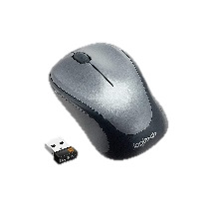
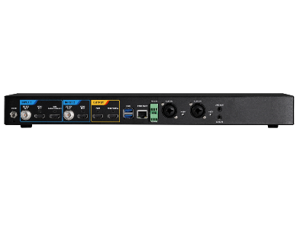
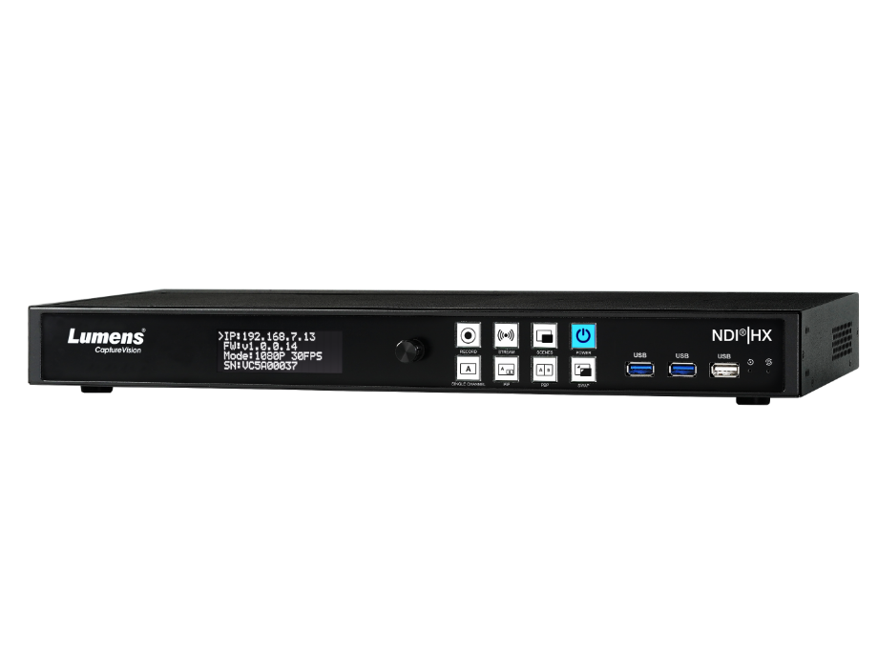
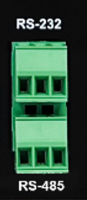
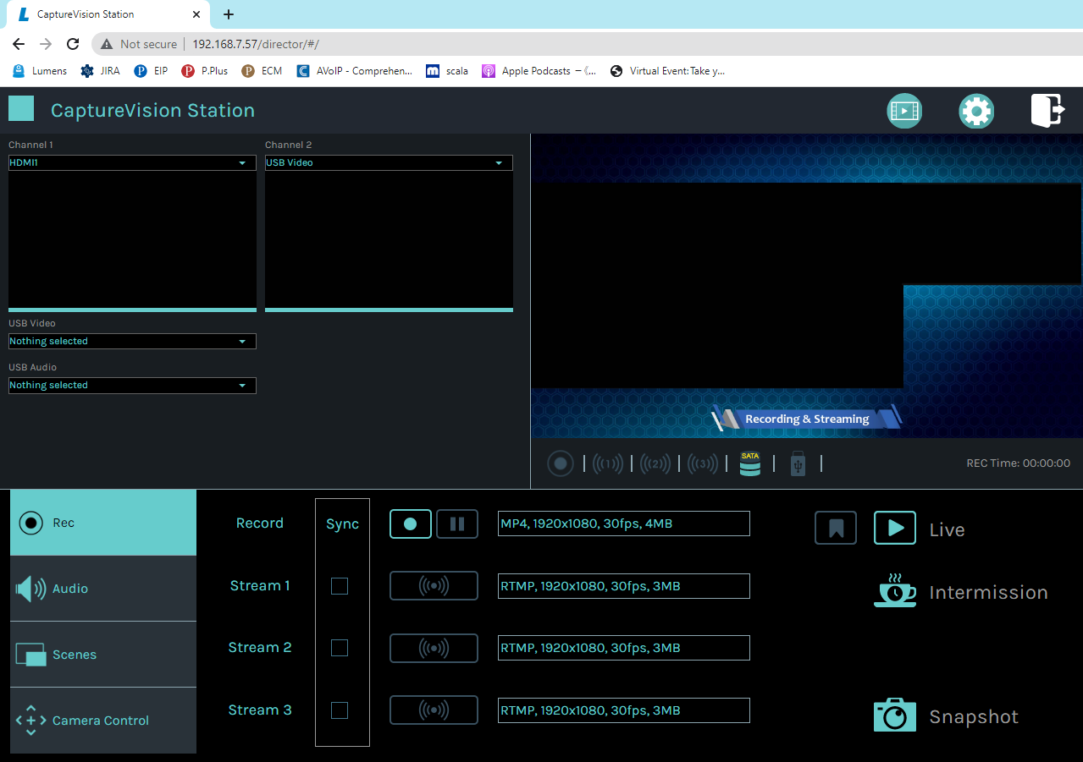
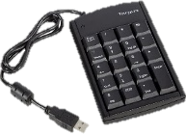
How to Control?
1
2
LC100N provide below control interface.
Remote control panel: LC-RC01
Onboard GUI Interface: Use mouse and keyboard to operate the GUI from Multiview HDMI out.
Online Director: Webpage
USB or wireless keypad: one click to record
RS-232, RS-485, TCP/IP control: Provide command for supporting third-party controller, like Crestron, Extron controllers.
Remote Control Panel
LC-RC01
Onboard GUI
with Wireless mouse
3
4
5
Web Online Director
USB Keypad
RS-232
RS-485
Notes:
LC100N provide several control interface.
Remote control panel: LC-RC01 , Onboard GUI Interface , Online Director, USB or wireless keypad, RS-232, RS-485, TCP,IP control.

Slide 15
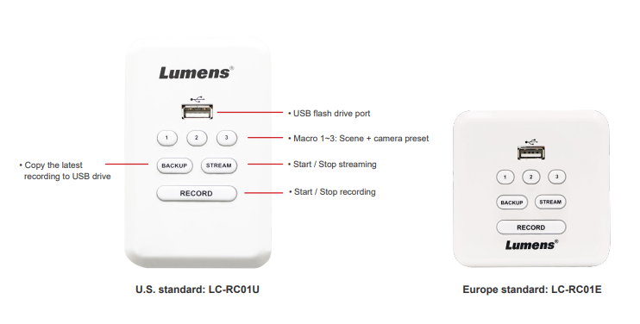
LC-RC01 Remote Control Panel
Accessory
Lumens LC-RC01 remote control panel, a wall plate for the LC100N to control the live streaming, recording, and video file saving options. The panel provides three macro functions that can remotely switch the scene and control the cameras preset. The LC-RC01 can be extended to 30 meters through a Cat 5e cable. Equipped with a USB port, it supports USB flash drives to record or backup video files.
*We provide two Standard remote control panels.
Notes:
Lumens LC-RC01 remote control panel, a wall plate for the LC100 and LC100N to control the live streaming, recording, and video file saving options. The panel provides three macro functions that can remotely switch the scene and control the cameras preset. The LC-RC01 can be extended to 30 meters through a Cat 5e cable. Equipped with a USB port, it supports USB flash drives to record or backup video files.

Slide 16
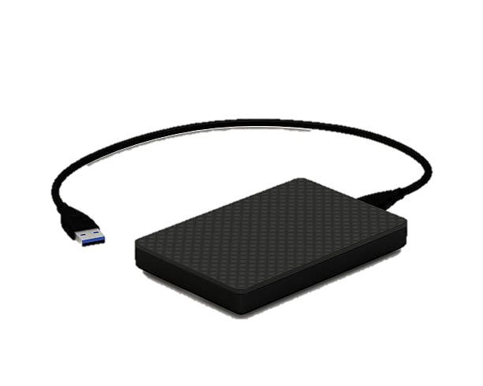
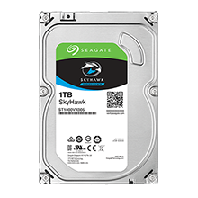
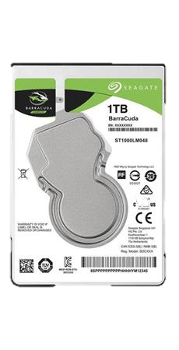
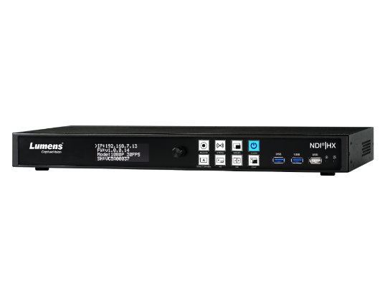
3 Local Storage Options
How to Backup Data (1)?
You can install your data in the build in 2TB storage, or if the build in 2TB is too small you can exchange to bigger Hard Disk, or you can add one external USB storage.
3.5”
2.5”
Exchange SATA Hard Disk Drive (up to 16 TB)
External USB Storage (up to 16 TB)
Built-in 2TB
Notes:
You can install your data in the build in 2TB storage, or if the build in 2TB is too small you can exchange to bigger Hard Disk, or you can add one external USB storage.

Slide 17
Network Storage
How to Backup Data (2)?
The built-in storage space is limited, and the video files must be uploaded to the network storage space automatically, for the user to backup and manage.
FTP
NAS
You can buckup to LMS (learning
management systems) like Panopto, Kaltura, and Opencast.
You can upload to NAS or FTP/SFTP server
Notes:
The built-in storage space is limited, and the video files must be uploaded to the network storage space automatically, for the user to backup and manage.
You can backup to LMS like Panopto, Kaltura, and Opencast.
You can upload to NAS or FTP, SFTP server.

Slide 18
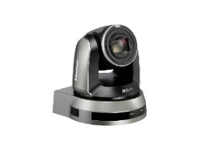
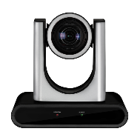
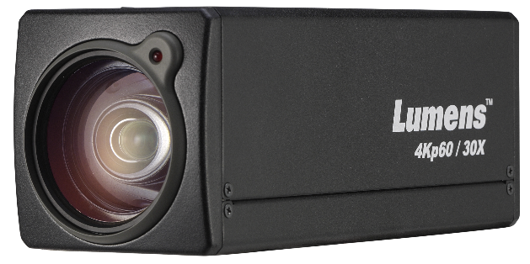
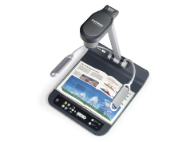
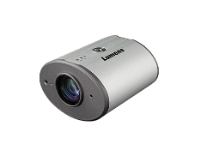
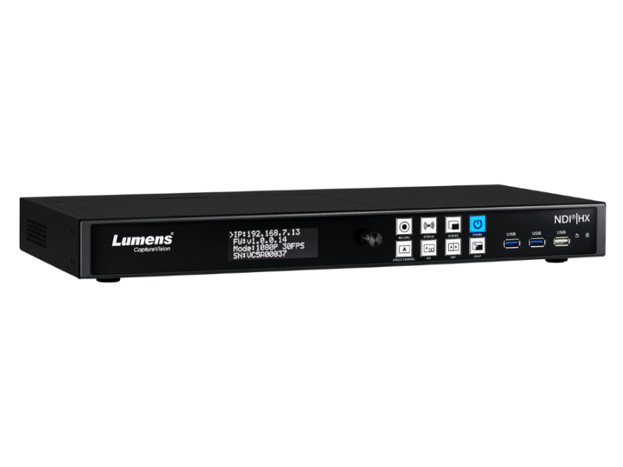
Lumens Products
Integration
LC100N is a powerful all-in-one Media Processor with HDMI, SDI, USB, NDI|HX, and RTSP inputs. The various AV inputs make it easier to connect with all ranges of Lumens cameras. LC100N is compatible with Lumens LC-RC01 Remote Control Panel and Lumens Deployment Tool software.
It allows you to remotely manage and control LC100N devices.
Camera
Remote Control Panel
Deployment Tool
Media Processor
Accessory
Software
Notes:
LC100N is a powerful all-in-one Media Processor with HDMI, SDI, USB, and NDI|HX or RTSP inputs.
The various AV inputs make it easier to connect with all ranges of Lumens cameras.
LC100N is compatible with Lumens LC-RC01 Remote Control Panel and Lumens Deployment Tool software.
It allows you to remotely manage and control LC100N devices.

Slide 19
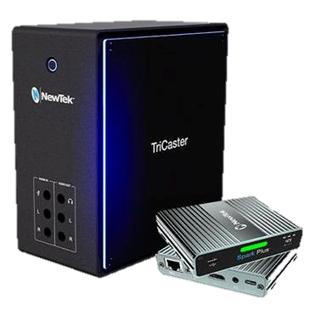
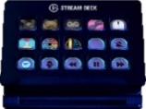
Third Party Partners
Integration
LC100N successfully integrates with major content management systems, popular streaming platforms, broadcasting software, and stream deck. It provides users with more flexible options to use LC100N with their desired platforms.
LC100N can be integrated into NDI network because it supports NDI|HX.
Stream Deck
NewTek TriCast
NDI|HX
Screen Capture
NDI Webcam Input
Video Content Management
Streaming Platform
Broadcasting Software
Notes:
LC100N successfully integrates with major content management systems, popular streaming platforms, broadcasting software, and stream deck.
Because it support NDI|HX, so it can support most NDI software and NDI production switcher.
It provides users with more flexible options to use LC100N with their desired platforms.

